Slide 1
MapChat
Team:
Peiyan Liu, Supreeth Kabbin, Sriya Mahankali
Spencer Ortega, Bailin Chen
Notes:
submit here: https://drive.google.com/drive/folders/1Czzi1ePTfXlxg99evnx5oVB2Yv6Sh6SE?usp=sharing

Slide 2
Goal/Motivation
English practicing game
Conversations from real world scenarios
For international students/tourists looking for extra practice
Fun and Interactive environment to learn in!

Slide 3
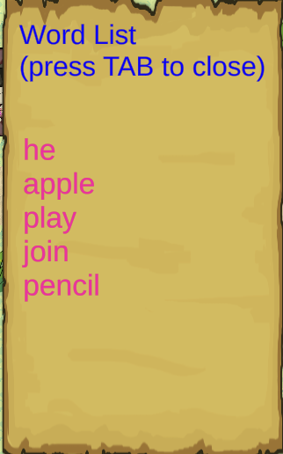
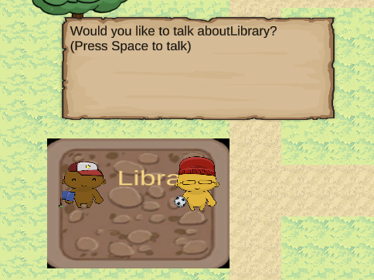
Game Overview
2D RPG style playground
Multiple "chat spots" representing real world locations
List of words for each level
Use every word in at least one "chat" to pass level
Must be grammatically correct and relevant to chat spot

Slide 4
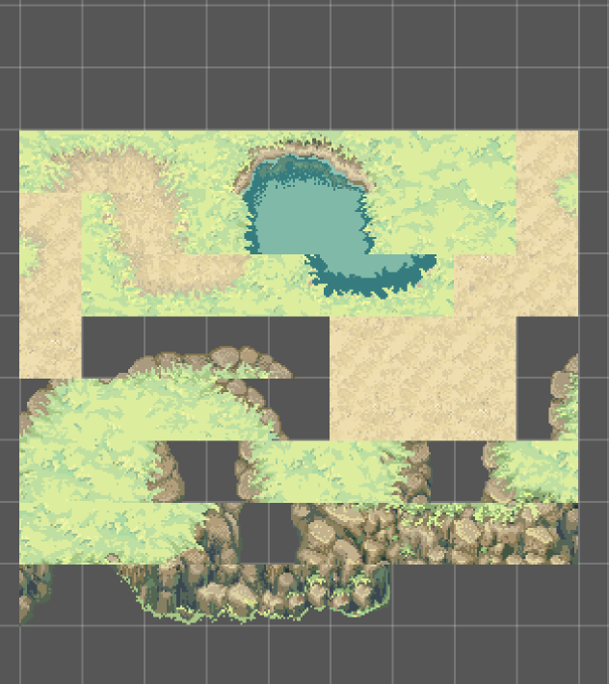
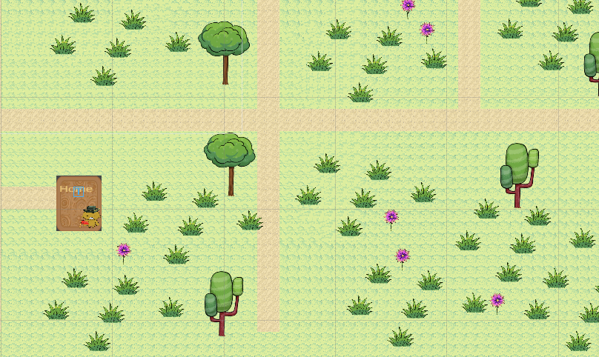
User-Interface
Unity as game engine
Tile Palette
Unity Assets

Slide 5
Speech to Text Training
Default Speech-to-text model not accurate in certain circumstance
Issues pertaining to :
Accent of user
Noisy background
Increase the accuracy by training the model
Using VOiCES open-source dataset

Slide 6

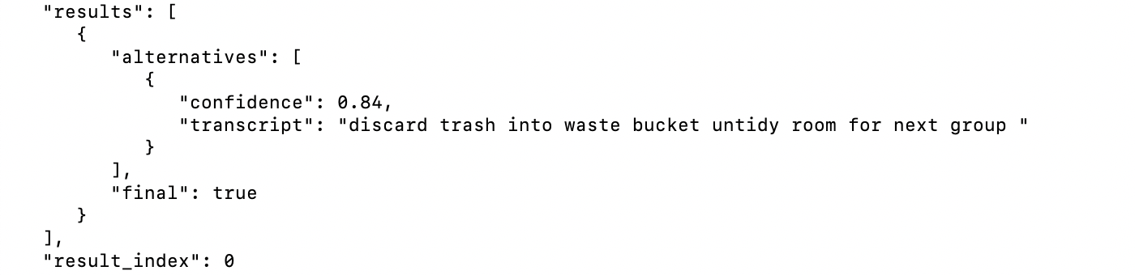
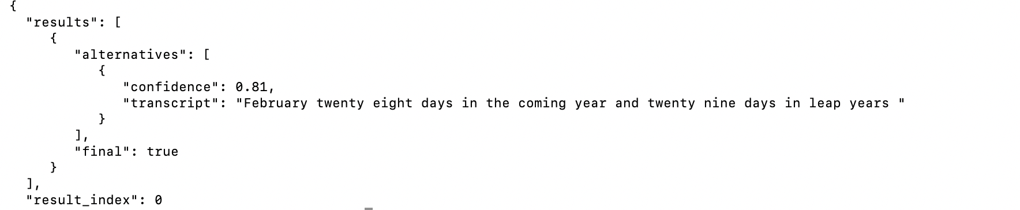
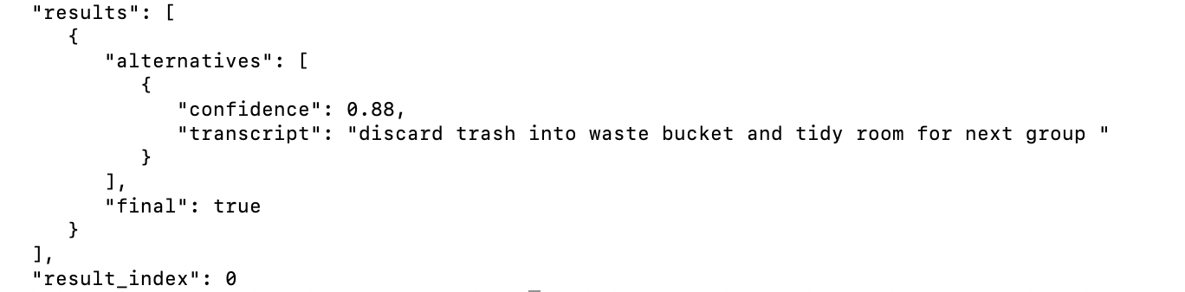
Speech to Text Training
NOISY
ACCENTED

Slide 7
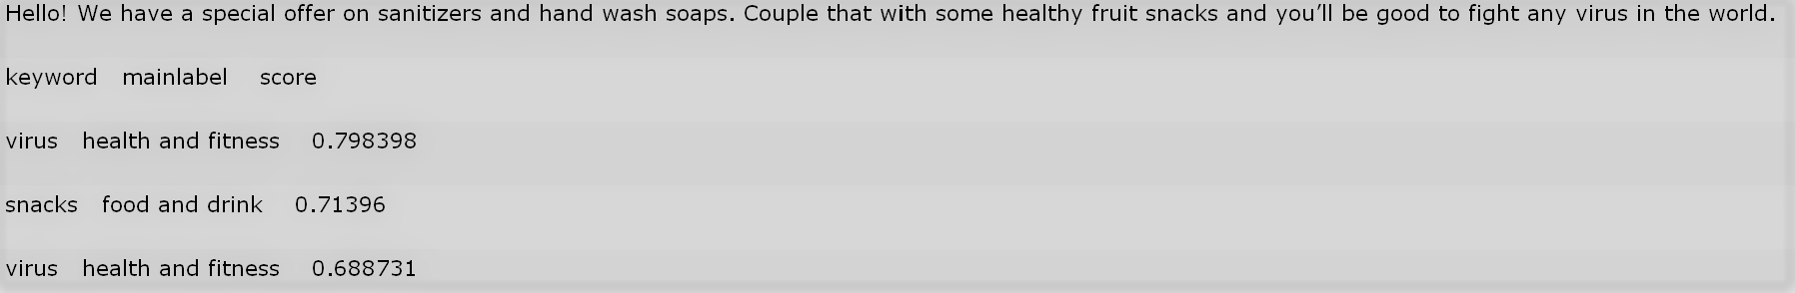
Natural Language Understanding
Implemented watson NLU in unity
Can output categories of user’s input
Used to match user input and current context via weighted average IOU

Slide 8
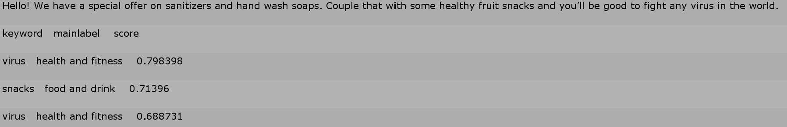
Natural Language Understanding
Calculate contextual similarity
Weighted Average Intersection Over Union
Relevance Threshold

Slide 9
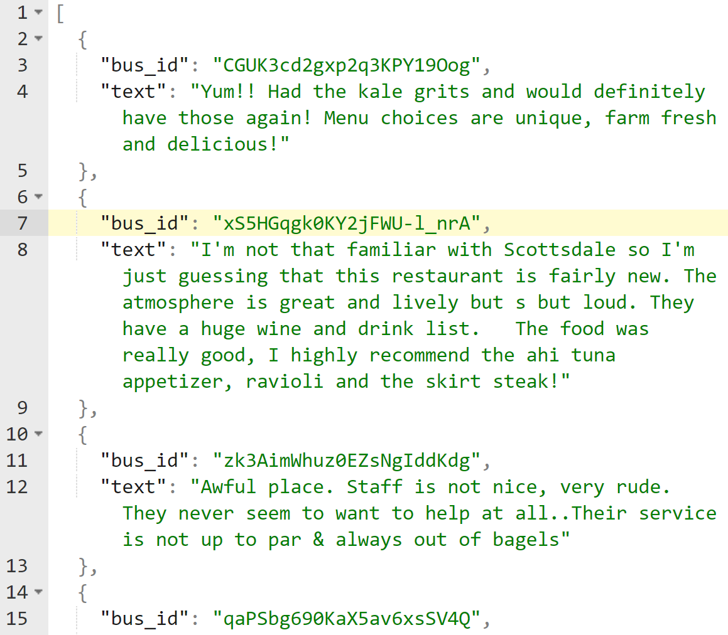
Content Generation
Natural Language Dataset: Yelp Reviews
Parsed and ready to train
Moving away from watson assistant as our mean of content generation
not suitable for our needs
Looking into open-source python text generation
TensorFlow, Keras, NLTK

Slide 10
Future Work
Improve Speech-to-Text and NLU with further training
Increase the applications of Speech Recognition - Voice directed actions / movement
Track player performance to dynamically generate further levels
Smart Content Generation
Increase UI detail and incorporate 2D Google Maps API.

Slide 11
MapChat Demo

Slide 12
